Slide 1
Lecture 12 : Synchronization Examples & Deadlocks

Slide 2
Outline
1. Classical Problems of Synchronization
Bounded Buffer Problem
Readers and Writers Problem
Dining Philosophers Problem
2. Examples of Synchronization Tools
3. Deadlock Problem
System Model
Deadlock Characterization
Resource-Allocation Graph
4. Methods for Handling Deadlocks
Deadlock Prevention
Deadlock Avoidance
Deadlock Detection
Deadlock Ignorance

Slide 3
Outline
KEYWORDS: Hold and wait, no preemption, circular wait, Deadlock Prevention, Deadlock Avoidance, Deadlock Detection, resource-allocation graph
HOMEWORK:
1) Reading : Chapter 8, especially the summary.
2) Make sure to understand and be able to explain every keyword from the list here and the ones which are printed bold in the text book.
3) Important Questions:
What is the Bounded-Buffer Problem ?
What is the Readers and Writers Problem ?
What is the Dining-Philosophers Problem ?
Give an example of deadlocks with a resource-allocation graph
What are the four necessary conditions needed for deadlock to occur?
List four overall strategies in handling deadlocks.
Consider a system consisting of four resources of the same type that are shared by three processes, each of which needs at most two resources. Can we have deadlock in the given system?
Compare deadlock and starvation.

Slide 4
Outline
1. Classical Problems of Synchronization
Bounded Buffer Problem
Readers and Writers Problem
Dining Philosophers Problem
2. Examples of Synchronization Tools
3. Deadlock Problem
System Model
Deadlock Characterization
Resource-Allocation Graph
4. Methods for Handling Deadlocks
Deadlock Prevention
Deadlock Avoidance
Deadlock Detection
Deadlock Ignorance

Slide 5
Classical Problems of Synchronization
Classical problems used to test newly-proposed synchronization schemes
Bounded-Buffer Problem
Readers and Writers Problem
Dining-Philosophers Problem

Slide 6
Bounded-Buffer Problem
n buffers, each can hold one item
Semaphore mutex initialized to the value 1
Semaphore full initialized to the value 0
Semaphore empty initialized to the value n

Slide 7
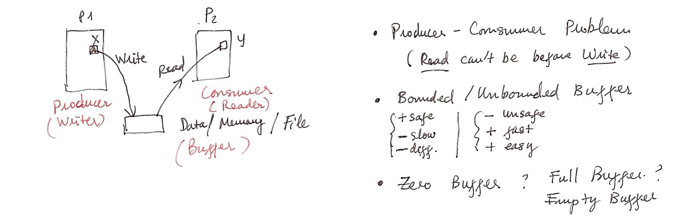
Bounded-Buffer Problem

Slide 8
Bounded Buffer Problem (Cont.)
The structure of the producer process
while (true) {
... /* produce an item in next_produced */
...
wait(empty);
wait(mutex);
... /* add next produced to the buffer */
...
signal(mutex);
signal(full);
}
The structure of the consumer process
while (true) {
wait(full);
wait(mutex);
... /* remove an item from buffer to next_consumed */
...
signal(mutex);
signal(empty);
... /* consume the item in next consumed */
... }

Slide 9
Outline
1. Classical Problems of Synchronization
Bounded Buffer Problem
Readers and Writers Problem
Dining Philosophers Problem
2. Examples of Synchronization Tools
3. Deadlock Problem
System Model
Deadlock Characterization
Resource-Allocation Graph
4. Methods for Handling Deadlocks
Deadlock Prevention
Deadlock Avoidance
Deadlock Detection
Deadlock Ignorance

Slide 10
Readers-Writers Problem
A data set is shared among a number of concurrent processes
Readers – only read the data set; they do not perform any updates
Writers – can both read and write
Problem – allow multiple readers to read at the same time
Only one single writer can access the shared data at the same time
Several variations of how readers and writers are considered – all involve some form of priorities

Slide 11
Readers-Writers Problem (Cont.)
Shared Data
Data set
Semaphore rw_mutex initialized to 1
Semaphore mutex initialized to 1
Integer read_count initialized to 0

Slide 12
Readers-Writers Problem

Slide 13
Readers-Writers Problem (Cont.)
The structure of a writer process
while (true) { wait(rw_mutex);
... /* writing is performed */
...
signal(rw_mutex);
}
The structure of a reader process
while (true){ wait(mutex); read_count++; if (read_count == 1) /* first reader */
wait(rw_mutex);
signal(mutex);
... /* reading is performed */
...
wait(mutex); read count--; if (read_count == 0) /* last reader */
signal(rw_mutex);
signal(mutex);
}

Slide 14
Readers-Writers Problem Variations
The solution in previous slide can result in a situation where a writer process never writes. It is referred to as the “First reader-writer” problem.
The “Second reader-writer” problem is a variation the first reader-writer problem that state:
Once a writer is ready to write, no “newly arrived reader” is allowed to read.
Both the first and second may result in starvation. leading to even more variations
Problem is solved on some systems by kernel providing reader-writer locks

Slide 15
Outline
1. Classical Problems of Synchronization
Bounded Buffer Problem
Readers and Writers Problem
Dining Philosophers Problem
2. Examples of Synchronization Tools
3. Deadlock Problem
System Model
Deadlock Characterization
Resource-Allocation Graph
4. Methods for Handling Deadlocks
Deadlock Prevention
Deadlock Avoidance
Deadlock Detection
Deadlock Ignorance

Slide 16

Dining-Philosophers Problem
N philosophers’ sit at a round table with a bowel of rice in the middle.
They spend their lives alternating thinking and eating.
They do not interact with their neighbors.
Occasionally try to pick up 2 chopsticks (one at a time) to eat from bowl
Need both to eat, then release both when done
In the case of 5 philosophers, the shared data
Bowl of rice (data set)
Semaphore chopstick [5] initialized to 1

Slide 17
Outline
1. Classical Problems of Synchronization
Bounded Buffer Problem
Readers and Writers Problem
Dining Philosophers Problem
2. Examples of Synchronization Tools
3. Deadlock Problem
System Model
Deadlock Characterization
Resource-Allocation Graph
4. Methods for Handling Deadlocks
Deadlock Prevention
Deadlock Avoidance
Deadlock Detection
Deadlock Ignorance

Slide 18
Kernel Synchronization - Windows
Uses interrupt masks to protect access to global resources on uniprocessor systems
Uses spinlocks on multiprocessor systems
Spinlocking-thread will never be preempted
Also provides dispatcher objects user-land which may act mutexes, semaphores, events, and timers
Events
An event acts much like a condition variable
Timers notify one or more thread when time expired
Dispatcher objects either signaled-state (object available) or non-signaled state (thread will block)

Slide 19
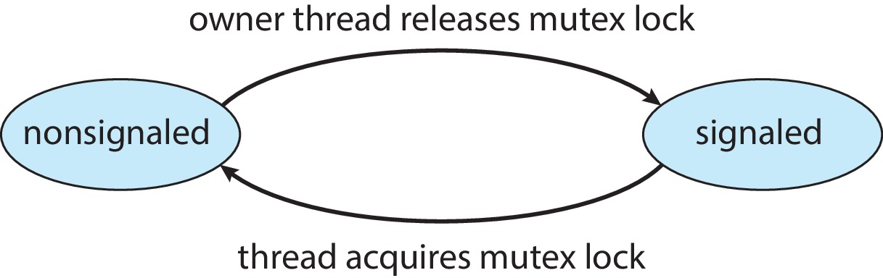
Kernel Synchronization - Windows
Mutex dispatcher object

Slide 20
Linux Synchronization
Linux:
Prior to kernel Version 2.6, disables interrupts to implement short critical sections
Version 2.6 and later, fully preemptive
Linux provides:
Semaphores
Atomic integers
Spinlocks
Reader-writer versions of both
On single-CPU system, spinlocks replaced by enabling and disabling kernel preemption

Slide 21
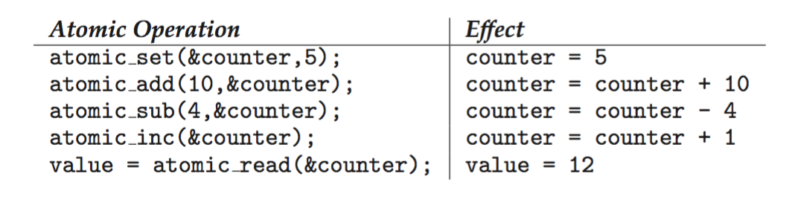
Linux Synchronization
Atomic variables atomic_t is the type for atomic integer
Consider the variables atomic_t counter; int value;

Slide 22
POSIX Synchronization
POSIX API provides
mutex locks
semaphores
condition variable
Widely used on UNIX, Linux, and macOS

Slide 23
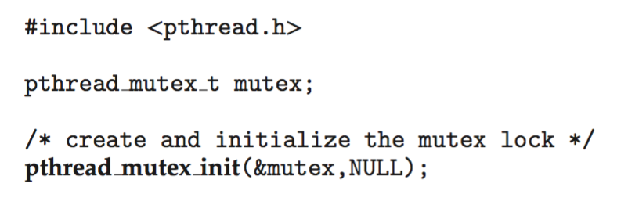
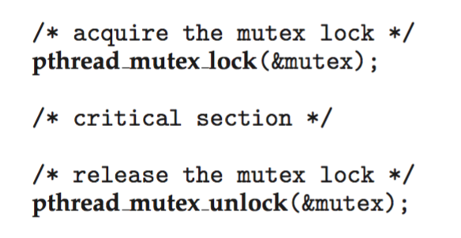
POSIX Mutex Locks
Creating and initializing the lock
Acquiring and releasing the lock

Slide 24
POSIX Semaphores
POSIX provides two versions – named and unnamed.
Named semaphores can be used by unrelated processes, unnamed cannot.

Slide 25
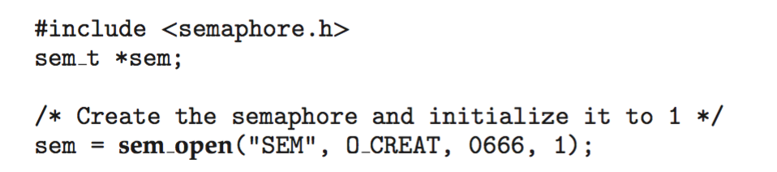
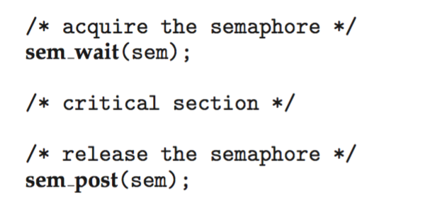
POSIX Named Semaphores
Creating an initializing the semaphore:
Another process can access the semaphore by referring to its name SEM.
Acquiring and releasing the semaphore:

Slide 26
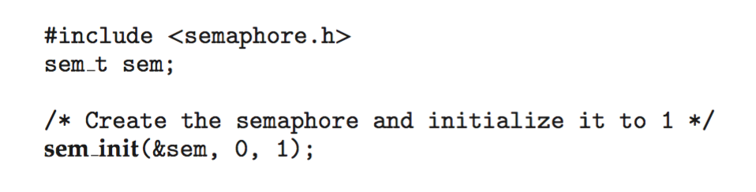
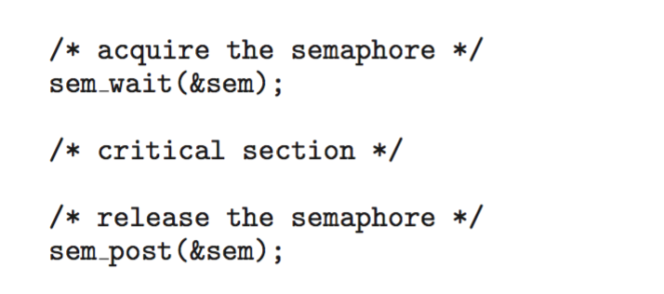
POSIX Unnamed Semaphores
Creating an initializing the semaphore:
Acquiring and releasing the semaphore:

Slide 27
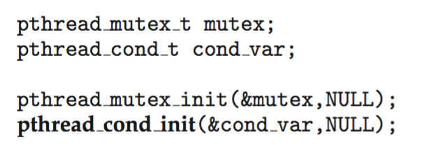
POSIX Condition Variables
Since POSIX is typically used in C/C++ and these languages do not provide a monitor, POSIX condition variables are associated with a POSIX mutex lock to provide mutual exclusion: Creating and initializing the condition variable:

Slide 28
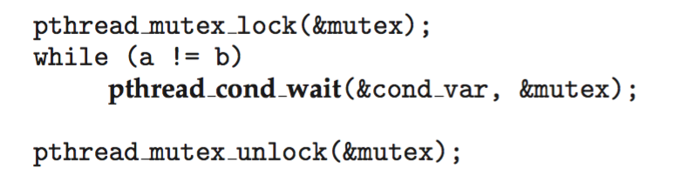
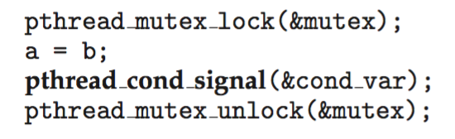
POSIX Condition Variables
Thread waiting for the condition a == b to become true:
Thread signaling another thread waiting on the condition variable:

Slide 29
Java Synchronization
Java provides rich set of synchronization features:
Java monitors
Reentrant locks
Semaphores
Condition variables

Slide 30
Java Monitors
Every Java object has associated with it a single lock.
If a method is declared as synchronized, a calling thread must own the lock for the object.
If the lock is owned by another thread, the calling thread must wait for the lock until it is released.
Locks are released when the owning thread exits the synchronized method.

Slide 31
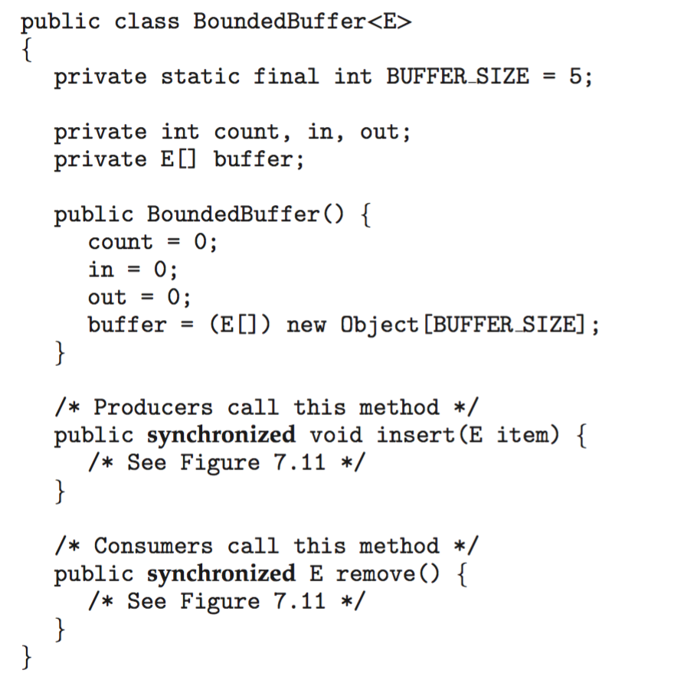
Bounded Buffer – Java Synchronization

Slide 32
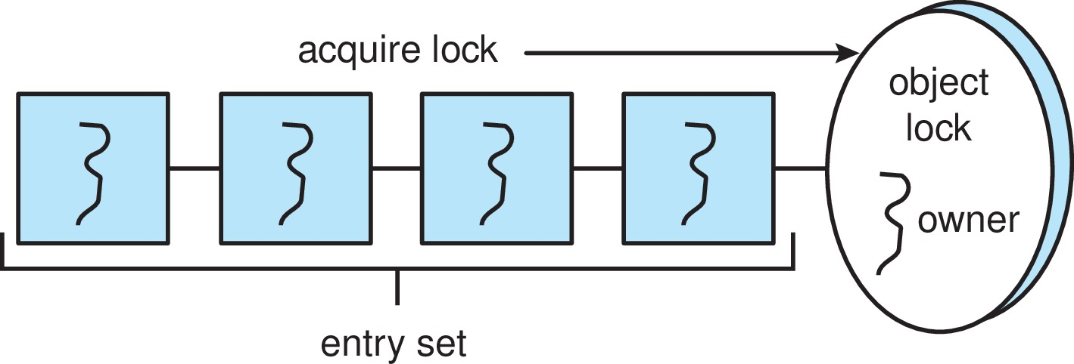
Java Synchronization
A thread that tries to acquire an unavailable lock is placed in the object’s entry set:

Slide 33
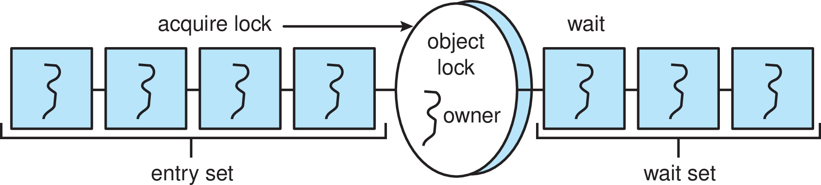
Java Synchronization
Similarly, each object also has a wait set.
When a thread calls wait():
It releases the lock for the object
The state of the thread is set to blocked
The thread is placed in the wait set for the object

Slide 34
Java Synchronization
A thread typically calls wait() when it is waiting for a condition to become true.
How does a thread get notified?
When a thread calls notify():
An arbitrary thread T is selected from the wait set
T is moved from the wait set to the entry set
Set the state of T from blocked to runnable.
T can now compete for the lock to check if the condition it was waiting for is now true.

Slide 35
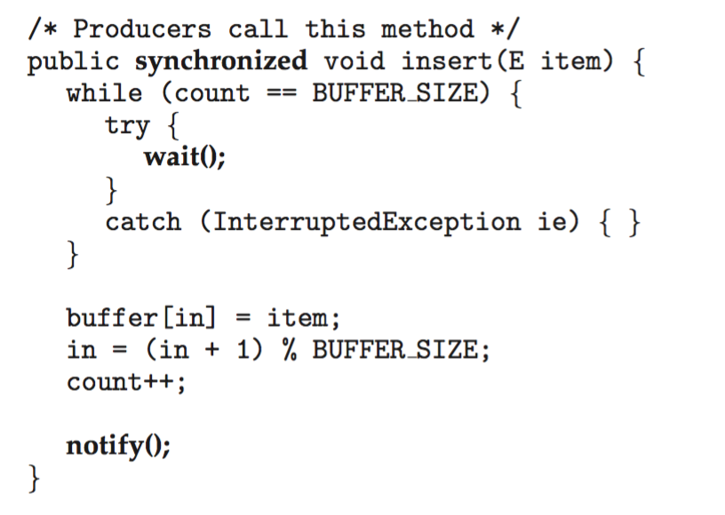
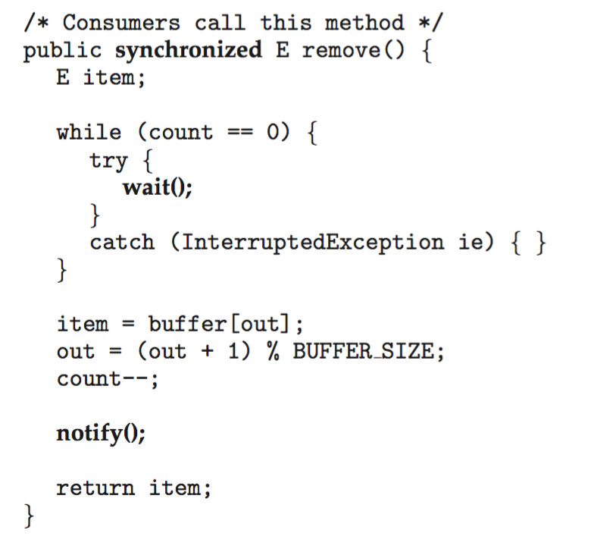
Bounded Buffer – Java Synchronization

Slide 36
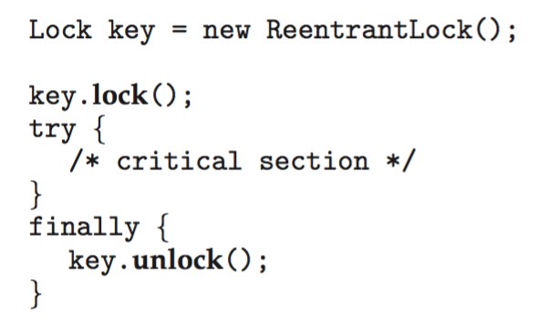
Java Reentrant Locks
Similar to mutex locks
The finally clause ensures the lock will be released in case an exception occurs in the try block.

Slide 37
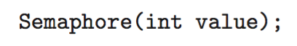
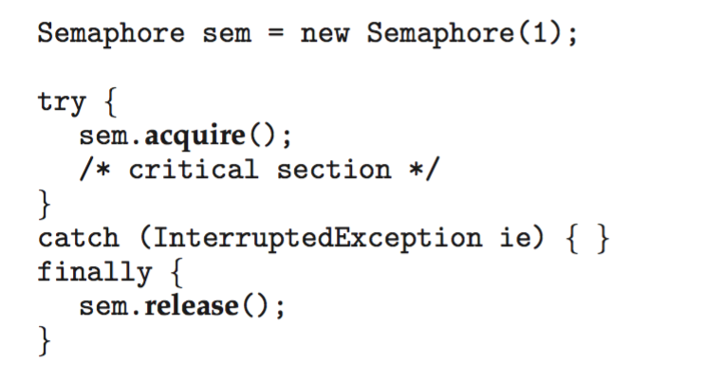
Java Semaphores
Constructor:
Usage:

Slide 38
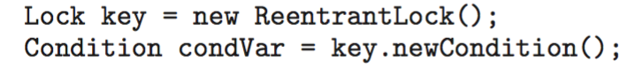
Java Condition Variables
Condition variables are associated with an ReentrantLock.
Creating a condition variable using newCondition() method of ReentrantLock:
A thread waits by calling the await() method, and signals by calling the signal() method.

Slide 39
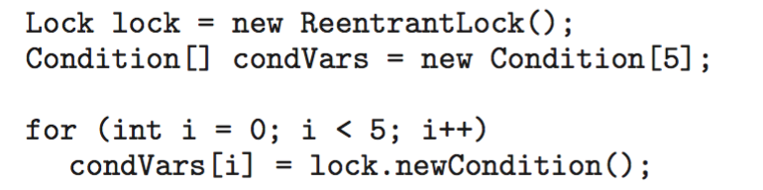
Java Condition Variables
Example:
Five threads numbered 0 .. 4
Shared variable turn indicating which thread’s turn it is.
Thread calls doWork() when it wishes to do some work. (But it may only do work if it is their turn.
If not their turn, wait
If their turn, do some work for awhile …...
When completed, notify the thread whose turn is next.
Necessary data structures:

Slide 40
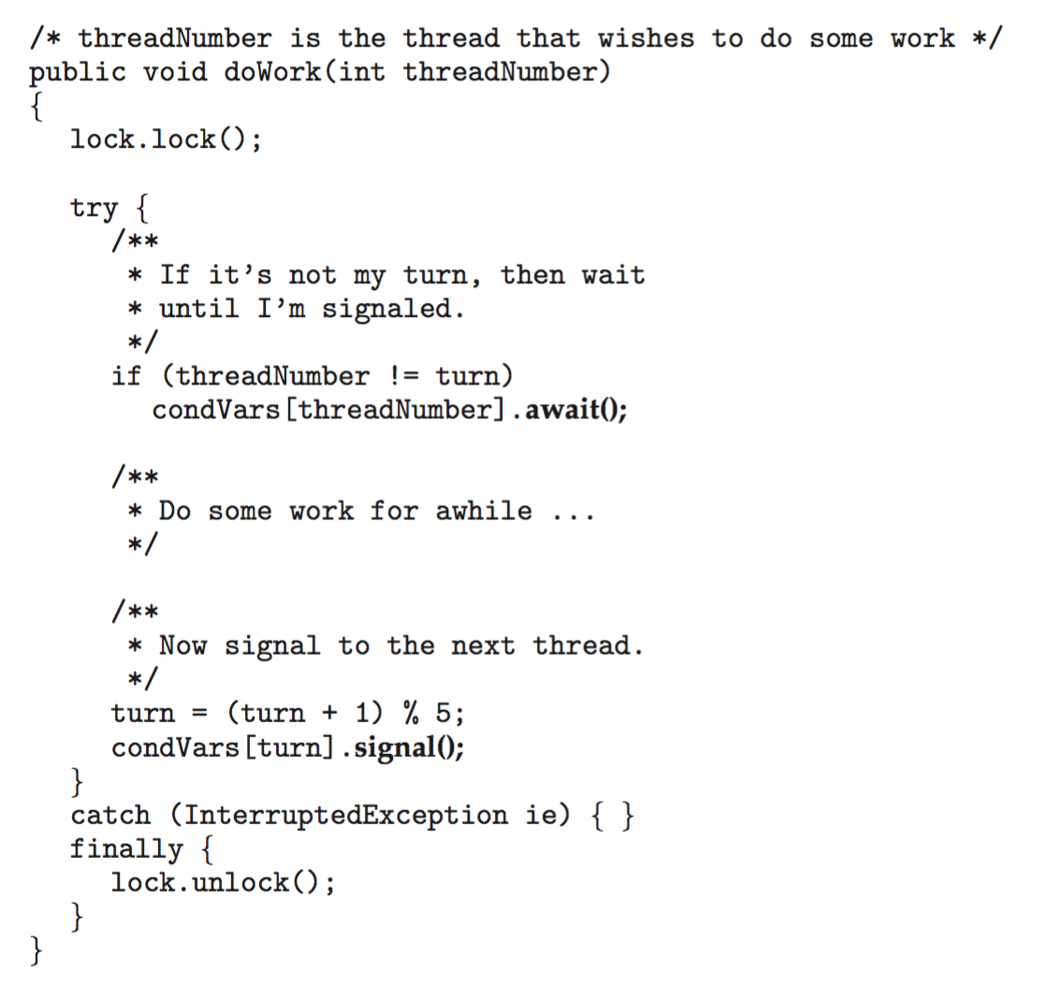
Java Condition Variables

Slide 41
Alternative Approaches
Transactional Memory
OpenMP
Functional Programming Languages

Slide 42
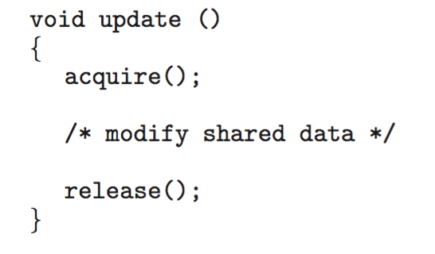
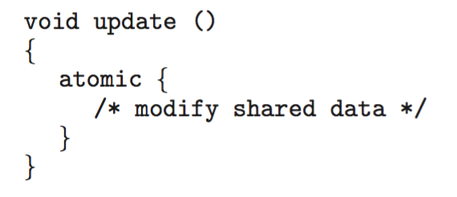
Transactional Memory
Consider a function update() that must be called atomically. One option is to use mutex locks:
A memory transaction is a sequence of read-write operations to memory that are performed atomically. A transaction can be completed by adding atomic{S} which ensure statements in S are executed atomically:

Slide 43
OpenMP
OpenMP is a set of compiler directives and API that support parallel progamming.
void update(int value)
{
#pragma omp critical
{
count += value
}
}
The code contained within the #pragma omp critical directive is treated as a critical section and performed atomically.

Slide 44
Functional Programming Languages
Functional programming languages offer a different paradigm than procedural languages in that they do not maintain state.
Variables are treated as immutable and cannot change state once they have been assigned a value.
There is increasing interest in functional languages such as Erlang and Scala for their approach in handling data races.

Slide 45
Outline
1. Classical Problems of Synchronization
Bounded Buffer Problem
Readers and Writers Problem
Dining Philosophers Problem
2. Examples of Synchronization Tools
3. Deadlock Problem
System Model
Deadlock Characterization
Resource-Allocation Graph
4. Methods for Handling Deadlocks
Deadlock Prevention
Deadlock Avoidance
Deadlock Detection
Deadlock Ignorance

Slide 46
System Model
System consists of resources
Resource types R₁, R₂, . . ., R_{m}
CPU cycles, memory space, I/O devices
Each resource type R_{i} has W_{i} instances.
Each process utilizes a resource as follows:
request
use
release

Slide 47
Deadlock with Semaphores
Data:
A semaphore S1 initialized to 1
A semaphore S2 initialized to 1
Two processes P1 and P2
P1:
wait(s1)
wait(s2)
P2:
wait(s2)
wait(s1)

Slide 48
Deadlock Characterization
Deadlock can arise if four conditions hold simultaneously.
Mutual exclusion: only one process at a time can use a resource
Hold and wait: a process holding at least one resource is waiting to acquire additional resources held by other processes
No preemption: a resource can be released only voluntarily by the process holding it, after that process has completed its task
Circular wait: there exists a set {P₀, P₁, …, P_{n}} of waiting processes such that P₀ is waiting for a resource that is held by P₁, P₁ is waiting for a resource that is held by P₂, …, P_{n–1} is waiting for a resource that is held by P_{n}, and P_{n} is waiting for a resource that is held by P₀.

Slide 49
Outline
1. Classical Problems of Synchronization
Bounded Buffer Problem
Readers and Writers Problem
Dining Philosophers Problem
2. Examples of Synchronization Tools
3. Deadlock Problem
System Model
Deadlock Characterization
Resource-Allocation Graph
4. Methods for Handling Deadlocks
Deadlock Prevention
Deadlock Avoidance
Deadlock Detection
Deadlock Ignorance

Slide 50
Resource-Allocation Graph
A set of vertices V and a set of edges E.
V is partitioned into two types:
P = {P₁, P₂, …, P_{n}}, the set consisting of all the processes in the system
R = {R₁, R₂, …, R_{m}}, the set consisting of all resource types in the system
request edge – directed edge P_{i} → R_{j}
assignment edge – directed edge R_{j} → P_{i}

Slide 51
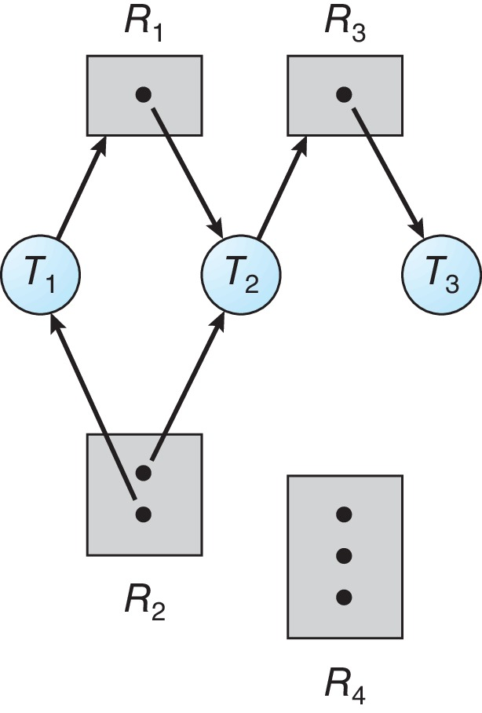
Resource Allocation Graph Example
One instance of R1
Two instances of R2
One instance of R3
Three instance of R4
T1 holds one instance of R2 and is waiting for an instance of R1
T2 holds one instance of R1, one instance of R2, and is waiting for an instance of R3
T3 is holds one instance of R3

Slide 52
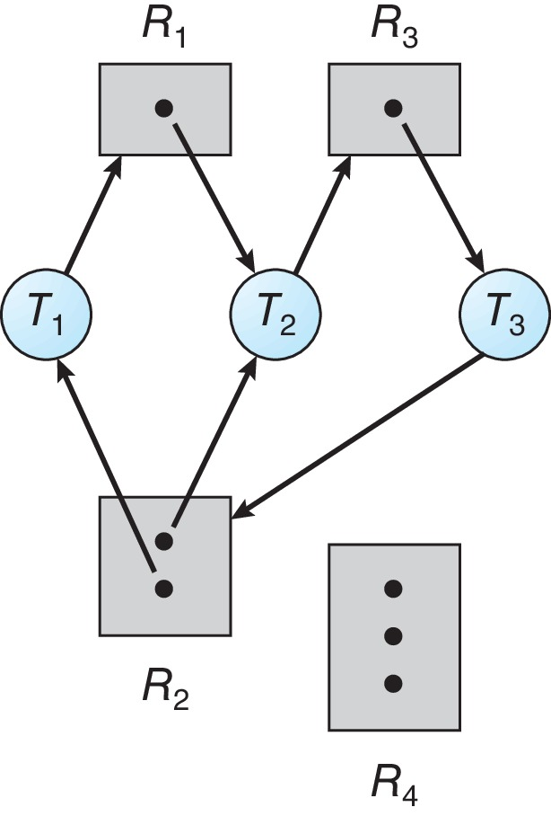
Resource Allocation Graph with a Deadlock

Slide 53
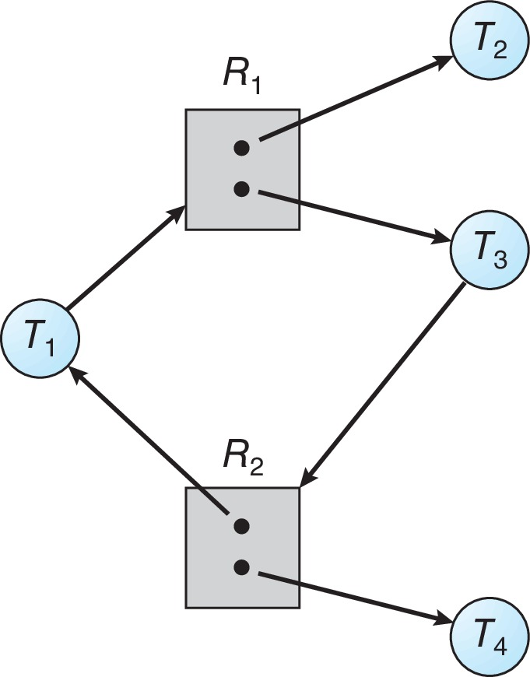
Graph with a Cycle But no Deadlock

Slide 54
Basic Facts
If graph contains no cycles ⇒ no deadlock
If graph contains a cycle ⇒
if only one instance per resource type, then deadlock
if several instances per resource type, possibility of deadlock

Slide 55
Outline
1. Classical Problems of Synchronization
Bounded Buffer Problem
Readers and Writers Problem
Dining Philosophers Problem
2. Examples of Synchronization Tools
3. Deadlock Problem
System Model
Deadlock Characterization
Resource-Allocation Graph
4. Methods for Handling Deadlocks
Deadlock Prevention
Deadlock Avoidance
Deadlock Detection
Deadlock Ignorance

Slide 56
Methods for Handling Deadlocks
Ensure that the system will never enter a deadlock state:
Deadlock prevention
Deadlock avoidance
Allow the system to enter a deadlock state and then recover
Ignore the problem and pretend that deadlocks never occur in the system.

Slide 57
Deadlock Prevention
Invalidate one of the four necessary conditions for deadlock:
Mutual Exclusion – not required for sharable resources (e.g., read-only files); must hold for non-sharable resources
Hold and Wait – must guarantee that whenever a process requests a resource, it does not hold any other resources
Require process to request and be allocated all its resources before it begins execution, or allow process to request resources only when the process has none allocated to it.
Low resource utilization; starvation possible

Slide 58
Deadlock Prevention (Cont.)
No Preemption:
If a process that is holding some resources requests another resource that cannot be immediately allocated to it, then all resources currently being held are released
Preempted resources are added to the list of resources for which the process is waiting
Process will be restarted only when it can regain its old resources, as well as the new ones that it is requesting
Circular Wait:
Impose a total ordering of all resource types, and require that each process requests resources in an increasing order of enumeration

Slide 59
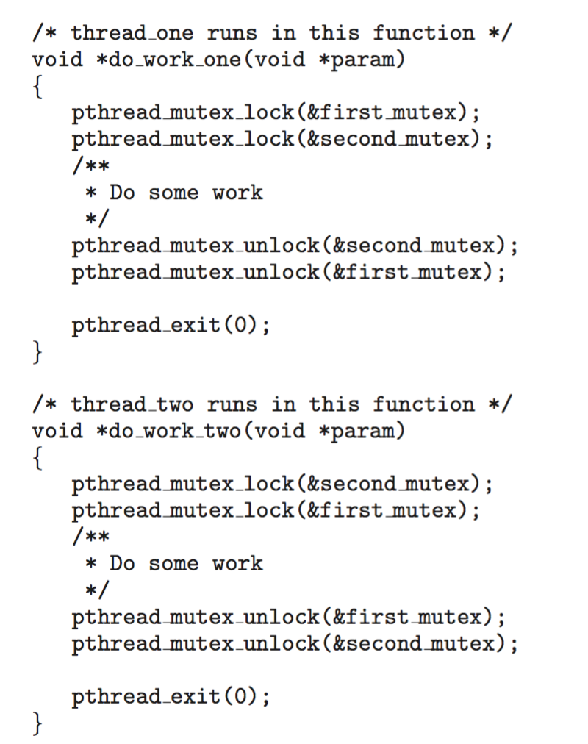
Circular Wait
Invalidating the circular wait condition is most common.
Simply assign each resource (i.e., mutex locks) a unique number.
Resources must be acquired in order.
If: first_mutex = 1 second_mutex = 5 code for thread_two could not be written as follows:

Slide 60
Outline
1. Classical Problems of Synchronization
Bounded Buffer Problem
Readers and Writers Problem
Dining Philosophers Problem
2. Examples of Synchronization Tools
3. Deadlock Problem
System Model
Deadlock Characterization
Resource-Allocation Graph
4. Methods for Handling Deadlocks
Deadlock Prevention
Deadlock Avoidance
Deadlock Detection
Deadlock Ignorance

Slide 61
Deadlock Avoidance
Requires that the system has some additional a priori information available
Simplest and most useful model requires that each process declare the maximum number of resources of each type that it may need
The deadlock-avoidance algorithm dynamically examines the resource-allocation state to ensure that there can never be a circular-wait condition
Resource-allocation state is defined by the number of available and allocated resources, and the maximum demands of the processes

Slide 62
Safe State
When a process requests an available resource, system must decide if immediate allocation leaves the system in a safe state
System is in safe state if there exists a sequence <P₁, P₂, …, P_{n}> of ALL the processes in the systems such that for each P_{i}, the resources that P_{i} can still request can be satisfied by currently available resources + resources held by all the P_{j}, with j < I
That is:
If P_{i} resource needs are not immediately available, then P_{i} can wait until all P_{j} have finished
When P_{j} is finished, P_{i} can obtain needed resources, execute, return allocated resources, and terminate
When P_{i} terminates, P_{i +1} can obtain its needed resources, and so on

Slide 63
Basic Facts
If a system is in safe state ⇒ no deadlocks
If a system is in unsafe state ⇒ possibility of deadlock
Avoidance ⇒ ensure that a system will never enter an unsafe state.

Slide 64
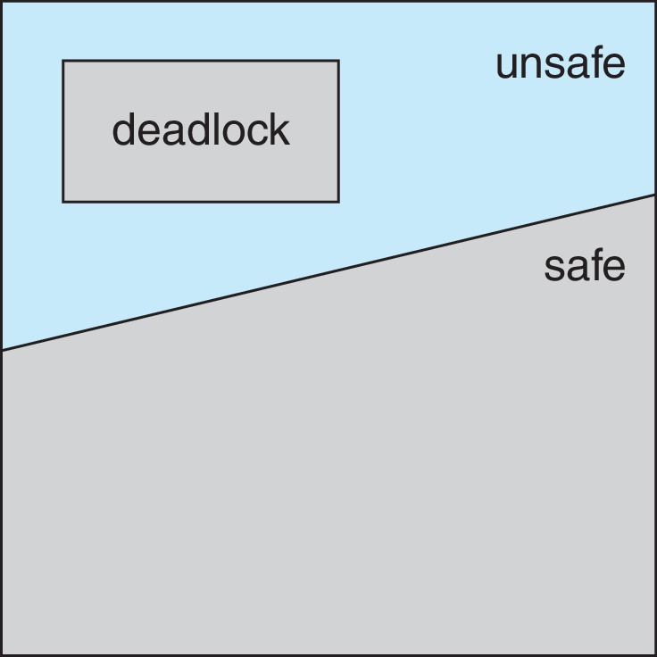
Safe, Unsafe, Deadlock State

Slide 65
Avoidance Algorithms
Single instance of a resource type
Use a resource-allocation graph
Multiple instances of a resource type
Use the Banker’s Algorithm

Slide 66
Resource-Allocation Graph Scheme
Claim edge P_{i} → R_{j} indicated that process P_{j} may request resource R_{j}; represented by a dashed line
Claim edge converts to request edge when a process requests a resource
Request edge converted to an assignment edge when the resource is allocated to the process
When a resource is released by a process, assignment edge reconverts to a claim edge
Resources must be claimed a priori in the system

Slide 67
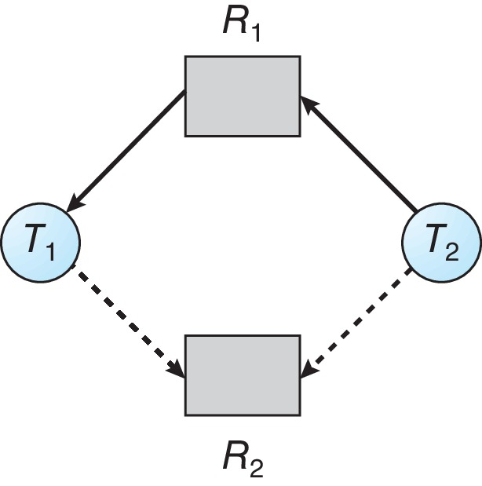
Resource-Allocation Graph

Slide 68
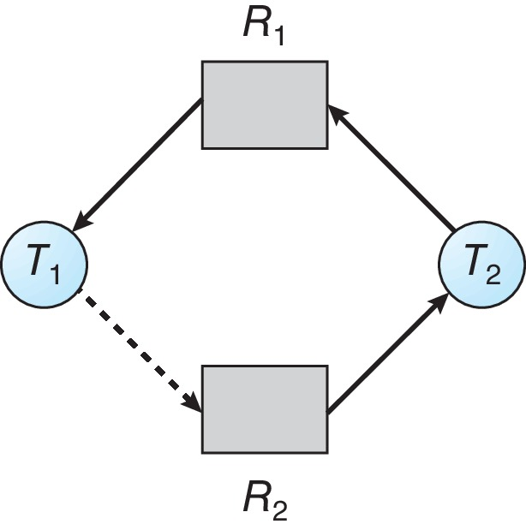
Unsafe State In Resource-Allocation Graph

Slide 69
Resource-Allocation Graph Algorithm
Suppose that process P_{i} requests a resource R_{j}
The request can be granted only if converting the request edge to an assignment edge does not result in the formation of a cycle in the resource allocation graph

Slide 70
Banker’s Algorithm
Multiple instances of resources
Each process must a priori claim maximum use
When a process requests a resource it may have to wait
When a process gets all its resources it must return them in a finite amount of time

Slide 71
Data Structures for the Banker’s Algorithm
Let n = number of processes, and m = number of resources types.
Available: Vector of length m. If available [j] = k, there are k instances of resource type R_{j} available
Max: n x m matrix. If Max [i,j] = k, then process P_{i} may request at most k instances of resource type R_{j}
Allocation: n x m matrix. If Allocation[i,j] = k then P_{i} is currently allocated k instances of R_{j}
Need: n x m matrix. If Need[i,j] = k, then P_{i} may need k more instances of R_{j} to complete its task
Need [i,j] = Max[i,j] – Allocation [i,j]

Slide 72
Safety Algorithm
Let Work and Finish be vectors of length m and n, respectively. Initialize:
Work = Available
Finish [i] = false for i = 0, 1, …, n- 1
Find an i such that both:
(a) Finish [i] = false
(b) Need_{i} ≤ Work
If no such i exists, go to step 4
Work = Work + Allocation_{i} Finish[i] = true go to step 2
If Finish [i] == true for all i, then the system is in a safe state

Slide 73
Resource-Request Algorithm for Process P_{i}
Request_{i} = request vector for process P_{i}. If Request_{i} [j] = k then process P_{i} wants k instances of resource type R_{j}
If Request_{i} ≤ Need_{i} go to step 2. Otherwise, raise error condition, since process has exceeded its maximum claim
If Request_{i} ≤ Available, go to step 3. Otherwise P_{i} must wait, since resources are not available
Pretend to allocate requested resources to P_{i} by modifying the state as follows:
Available = Available – Request_{i};
Allocation_{i} = Allocation_{i} + Request_{i};
Need_{i} = Need_{i} – Request_{i};
If safe ⇒ the resources are allocated to P_{i}
If unsafe ⇒ P_{i} must wait, and the old resource-allocation state is restored

Slide 74
Example of Banker’s Algorithm
5 processes P₀ through P₄;
3 resource types:
A (10 instances), B (5instances), and C (7 instances)
Snapshot at time T₀:
Allocation Max Available
A B C A B C A B C
P₀ 0 1 0 7 5 3 3 3 2
P₁ 2 0 0 3 2 2
P₂ 3 0 2 9 0 2
P₃ 2 1 1 2 2 2
P₄ 0 0 2 4 3 3

Slide 75
Example (Cont.)
The content of the matrix Need is defined to be Max – Allocation
Need
A B C
P₀ 7 4 3
P₁ 1 2 2
P₂ 6 0 0
P₃ 0 1 1
P₄ 4 3 1
The system is in a safe state since the sequence < P₁, P₃, P₄, P₂, P₀> satisfies safety criteria

Slide 76
Example: P₁ Request (1,0,2)
Check that Request ≤ Available (that is, (1,0,2) ≤ (3,3,2) ⇒ true
Allocation Need Available
A B C A B C A B C
P₀ 0 1 0 7 4 3 2 3 0
P₁ 3 0 2 0 2 0
P₂ 3 0 2 6 0 0
P₃ 2 1 1 0 1 1
P₄ 0 0 2 4 3 1
Executing safety algorithm shows that sequence < P₁, P₃, P₄, P₀, P₂> satisfies safety requirement
Can request for (3,3,0) by P₄ be granted?
Can request for (0,2,0) by P₀ be granted?

Slide 77
Outline
1. Classical Problems of Synchronization
Bounded Buffer Problem
Readers and Writers Problem
Dining Philosophers Problem
2. Examples of Synchronization Tools
3. Deadlock Problem
System Model
Deadlock Characterization
Resource-Allocation Graph
4. Methods for Handling Deadlocks
Deadlock Prevention
Deadlock Avoidance
Deadlock Detection
Deadlock Ignorance

Slide 78
Deadlock Detection
Allow system to enter deadlock state
Detection algorithm
Recovery scheme

Slide 79
Single Instance of Each Resource Type
Maintain wait-for graph
Nodes are processes
P_{i} → P_{j} if P_{i} is waiting for P_{j}
Periodically invoke an algorithm that searches for a cycle in the graph. If there is a cycle, there exists a deadlock
An algorithm to detect a cycle in a graph requires an order of n² operations, where n is the number of vertices in the graph

Slide 80
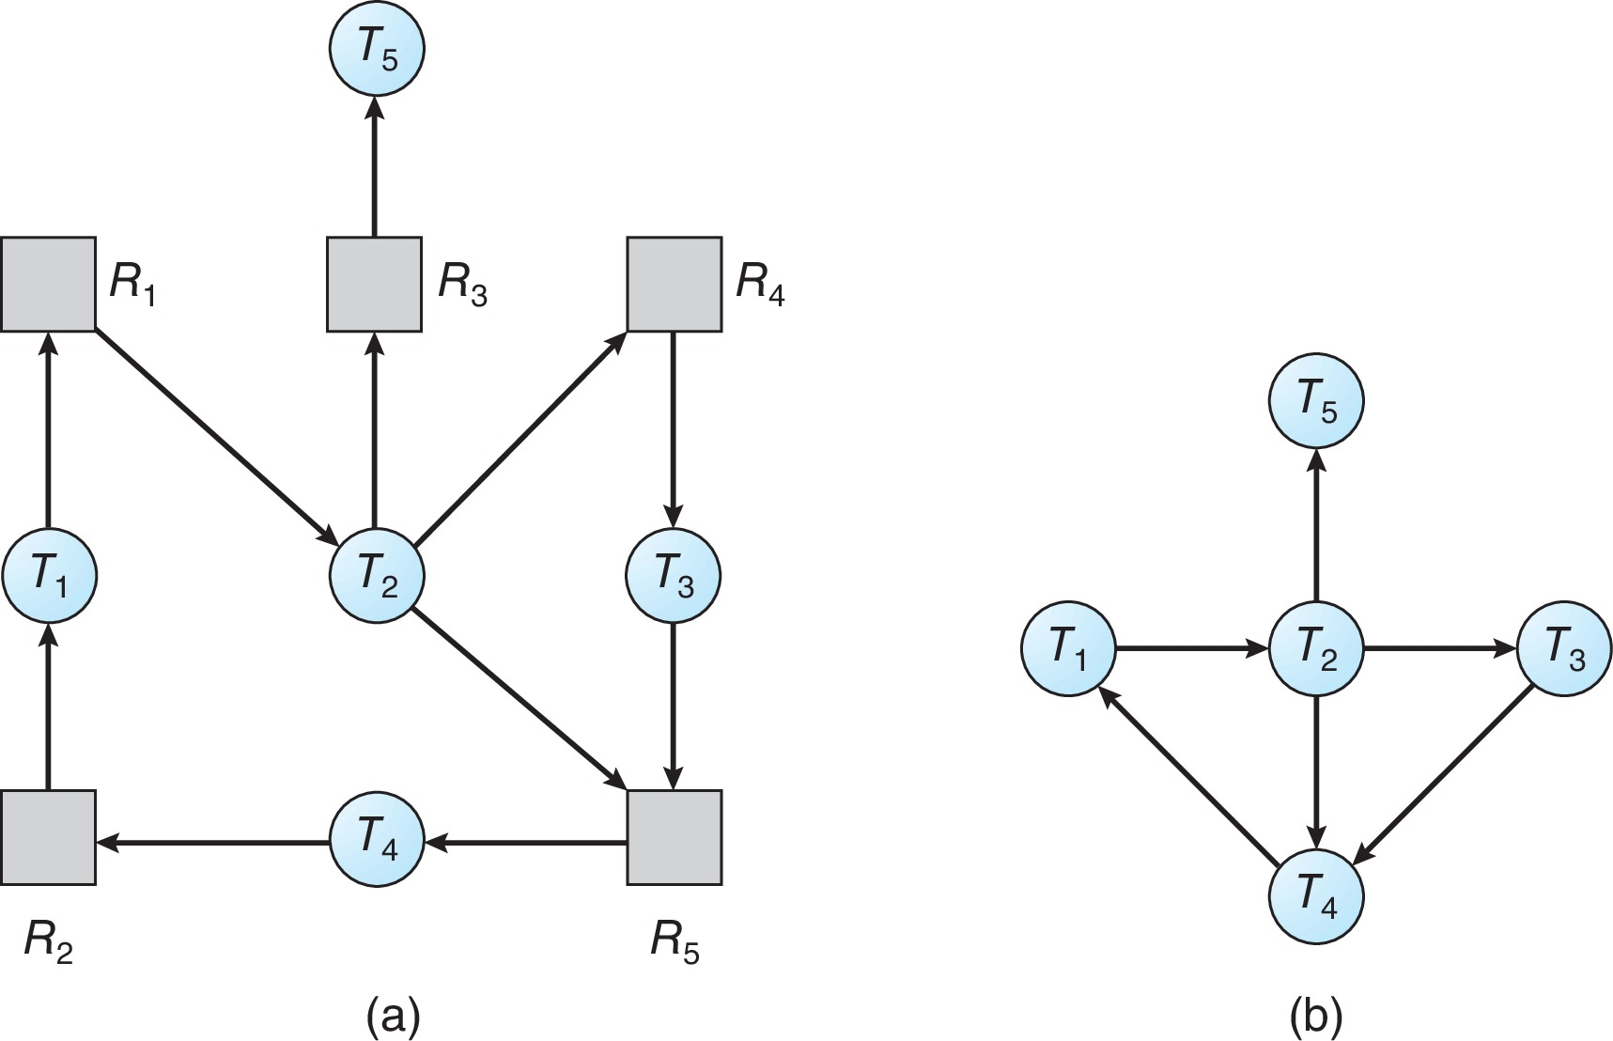
Resource-Allocation Graph and Wait-for Graph
Resource-Allocation Graph
Corresponding wait-for graph

Slide 81
Several Instances of a Resource Type
Available: A vector of length m indicates the number of available resources of each type
Allocation: An n x m matrix defines the number of resources of each type currently allocated to each process
Request: An n x m matrix indicates the current request of each process. If Request [i][j] = k, then process P_{i} is requesting k more instances of resource type R_{j}.

Slide 82
Detection Algorithm
Let Work and Finish be vectors of length m and n, respectively Initialize:
Work = Available
For i = 1,2, …, n, if Allocation_{i} ≠ 0, then Finish[i] = false; otherwise, Finish[i] = true
Find an index i such that both:
Finish[i] == false
Request_{i} ≤ Work
If no such i exists, go to step 4

Slide 83
Detection Algorithm (Cont.)
Work = Work + Allocation_{i} Finish[i] = true go to step 2
If Finish[i] == false, for some i, 1 ≤ i ≤ n, then the system is in deadlock state. Moreover, if Finish[i] == false, then P_{i} is deadlocked
Algorithm requires an order of O(m x n²) operations to detect whether the system is in deadlocked state

Slide 84
Example of Detection Algorithm
Five processes P₀ through P₄; three resource types A (7 instances), B (2 instances), and C (6 instances)
Snapshot at time T₀:
Allocation Request Available
A B C A B C A B C
P₀ 0 1 0 0 0 0 0 0 0
P₁ 2 0 0 2 0 2
P₂ 3 0 3 0 0 0
P₃ 2 1 1 1 0 0
P₄ 0 0 2 0 0 2
Sequence <P₀, P₂, P₃, P₁, P₄> will result in Finish[i] = true for all i

Slide 85
Example (Cont.)
P₂ requests an additional instance of type C
Request
A B C
P₀ 0 0 0
P₁ 2 0 2
P₂ 0 0 1
P₃ 1 0 0
P₄ 0 0 2
State of system?
Can reclaim resources held by process P₀, but insufficient resources to fulfill other processes; requests
Deadlock exists, consisting of processes P₁, P₂, P₃, and P₄

Slide 86
Detection-Algorithm Usage
When, and how often, to invoke depends on:
How often a deadlock is likely to occur?
How many processes will need to be rolled back?
one for each disjoint cycle
If detection algorithm is invoked arbitrarily, there may be many cycles in the resource graph and so we would not be able to tell which of the many deadlocked processes “caused” the deadlock.

Slide 87
Recovery from Deadlock: Process Termination
Abort all deadlocked processes
Abort one process at a time until the deadlock cycle is eliminated
In which order should we choose to abort?
Priority of the process
How long process has computed, and how much longer to completion
Resources the process has used
Resources process needs to complete
How many processes will need to be terminated
Is process interactive or batch?

Slide 88
Recovery from Deadlock: Resource Preemption
Selecting a victim – minimize cost
Rollback – return to some safe state, restart process for that state
Starvation – same process may always be picked as victim, include number of rollback in cost factor

Slide 89
Deadlock Ignorance
Do NOTHING !
Benefits: SIMPLE, FAST

